Slide 1

Marathwada Mitra Mandal's College of Engineering, Pune
Self Driving Car Simulation
Domain : Deep Learning
Yash Dagadkhair - SC213
Akshay Dongare - SC219
Jaydatta Patwe - SC224
Chinmay Kale - SC226
Guided by - Prof. Jagruti A. Wagh

Slide 2
Index
Problem Statement
Introduction
Abstract
Motivation
Literature Survey
Objectives
Methodology & Proposed System Block Diagram
Software & Hardware requirements
Implementation
Advantages-Disadvantages
Results
Applications
Conclusion
References

Slide 3
Problem Statement
To implement a simulation of self-driving car using deep learning algorithms to reduce road fatalities and other problems related to manual driving.

Slide 4
Introduction
Self-driving vehicles are cars or trucks in which human drivers are never required to take control to safely operate the vehicle.
Also known as autonomous or “driverless” cars, they combine sensors and software to control, navigate, and drive the vehicle. This project focuses on developing a simulation for a self-driving car.
Overall, this project of ours will help to reduce road accidents that occur due to manual malfunctions or from mistakes of driver.
This project has many features which were not involved in the previous versions of the self-driving cars simulation like the car model is trained on different tracks.

Slide 5
Abstract
In this project, we have trained a CNN using images captured by a simulated car in order to drive the car autonomously. The CNN learns unique features from the images and generates steering predictions allowing the car to drive without a human. For testing purposes and preparing the dataset the Unity based simulator provided by Udacity was used.
The system automatically learns internal representations of the necessary processing steps such as detecting useful road features with only the human steering angle as the training signal. We never explicitly trained it to detect, for example, the outline of roads.

Slide 6
Motivation
Every year the lives of approximately 1.3 million people are cut short as a result of a road traffic crash. Between 20 and 50 million more people suffer non-fatal injuries, with many incurring a disability as a result of their injury.
Driver behaviour is responsible for 94% of all vehicle crashes. Problems with inattentive or distracted driving are pooled into a category responsible for over 40% of crashes. Poor decisions account for 1/3 of vehicle accidents. The risk of a fatal car accident increases by 4% by every 1% your speed increases.

Slide 7
Literature Survey
End-to-End Learning for Self Driving Cars, published by NVIDIA Corporation, Published on 25 Apr 2016, pages 9. | Inspired from DAVE-2 architecture Tested the CNN in simulation before moving on to road testing Model learnt to detect the outline of a road without the need of explicit labels during training
Explaining How a Deep Neural Network Trained with End to End Learning Steers a Car, published by NVIDIA Corporation. Published in April 2017, Pages 8. | Added a visualization method that identifies the salient objects through averaging and scaling Eliminated the need for hand-coding rules and instead create a system that learns by observing

Slide 8
Objectives
The objective of this project is to successfully implement a self-driving car algorithm (CNN) simulation.

Slide 9
Methodology and Proposed System Block Diagrams
The neural networks identify patterns in the data which is fed to machine learning algorithms. The data includes images from cameras of self driving cars from which the neural network can learn to identify traffic lights, trees, curbs, pedestrians and other obstacles of any given part of the driving environment.
Trained model predicts value of steering angle
Python client passes these predictions to simulator server

Slide 10
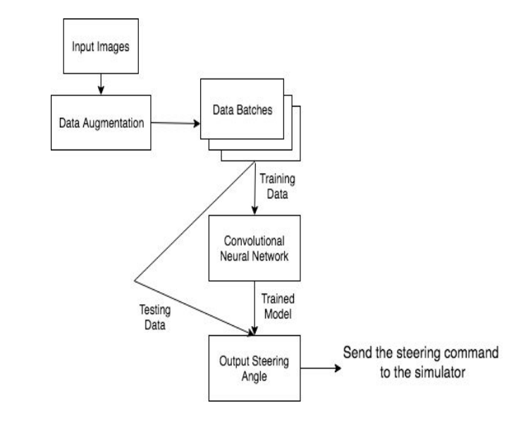
High Level System Architecture

Slide 11
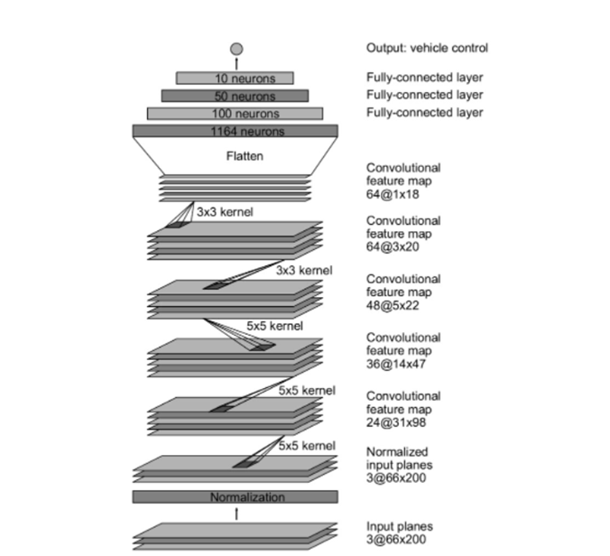
Deep Network Architecture

Slide 12
Software and Hardware Requirements
Software Requirements:
Anaconda
Keras(Tensorflow Backend)
Flask
Python
OpenCV
SocketIO
Unity 3D
Hardware Requirements:
CPU
GPU(Optional)

Slide 13
Implementation
For training images, frames were captured at 10 FPS from simulator. The captured images were then converted into a ‘pandas’ dataframe for easier manipulation. Then we balanced the imbalanced class by deleting redundant photos to ensure unbiased training. Deep learning algorithms perform better when provided a large amount of data, hence, we augmented the training data artificially using methods to flip the images, change brightness, shear, pan zoom, etc.
Then we generated batches of appropriate size for training and wrote the model arch. And used adam optimiser as loss function.

Slide 14
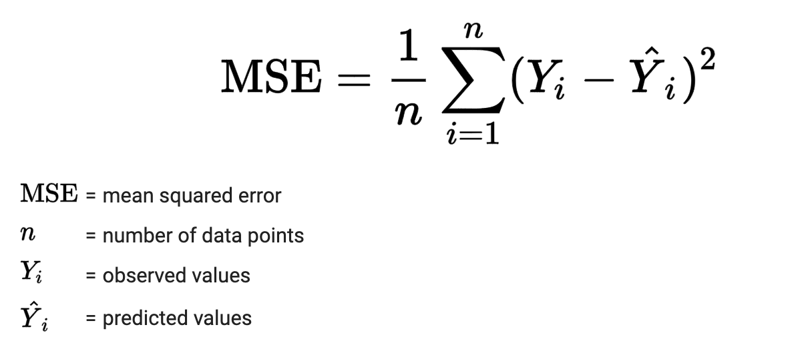
Loss Functions
For performance evaluation during training, mean squared error was used as a loss function to keep a track of the performance of the model.
We experimented with different loss functions and found MSE to be apposite.

Slide 15
Advantages
It reduces human error.
Lessens Traffic Jam.
Accessibility to transportation.
Time Saving.
Decreased number of accidents.

Slide 16
Disadvantages
Expensive
Prone to hacking,
Fewer job opportunities due to automation.
Non-functional sensors.

Slide 17
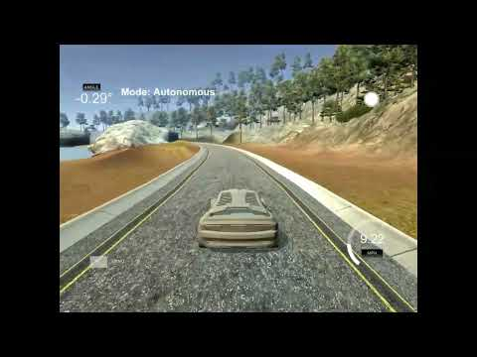
Results

Slide 18
Applications
For farming vehicles such as irrigators, tractors, and buggies, mining vehicles such as drilling rigs.
Industrial vehicles like forklifts and car crash testing vehicles.
Can be used in Parking shuttles.
As a means of transportation on Airports.
Can be used to automate any type of vehicles.
Can be used in Open World games to add a layer of reality and variability.

Slide 19
Future Scope
This concept will make your cars or automobiles fully automated reducing the scope of road accidents.
The self-driving car algorithm can be used to develop automobiles which are generally used in terrains where driving is relatively difficult. Same Concept can be used in military vehicles to avoid human casualties.
Apart from the algorithm the simulation of self-driving car can be used to make NPCs in video games more interesting.

Slide 20
Conclusion
In this project, we were able to successfully predict the steering angles using convolutional neural networks and were able to understand the inner details of convolutional neural networks along with the way they can be tuned. We also demonstrated that CNN’s are able to learn the entire task of lane and road following without manual decomposition into road or lane marking detection, semantic abstraction, path planning, and control. A small amount of training data from less than a hundred hours of driving was sufficient to train the car to operate in diverse conditions, on highways, local and residential roads in sunny, cloudy, and rainy conditions. An interesting caveat to this is that the system was able to successfully drive on the roads that it had been trained on. Autonomous systems for vehicles that don’t use the Udacity simulator require a greater robustness as they have to take into consideration roads that haven’t been driven on and a greater amount of obstacles such as pedestrians and stop signs. However, the task defined in our paper was successfully accomplished.

Slide 21
References
End-to-End Learning for Self Driving Cars, published by NVIDIA Corporation, Published on 25 Apr 2016, pages 9.
Explaining How a Deep Neural Network Trained with End to End Learning Steers a Car, published by NVIDIA Corporation. Published in April 2017, Pages 8.
LeCun, Y., et al. DAVE: Autonomous off-road vehicle control using end-to-end learning. Technical Report DARPA-IPTO Final Report, Courant Institute/CBLL, http://www. cs. nyu. edu/yann/research/dave/index. html, 2004.
Pomerleau, Dean A. "Alvinn: An autonomous land vehicle in a neural network." Advances in neural information processing systems. 1989.
Bojarski, Mariusz, et al. "End to end learning for self-driving cars." arXiv preprint arXiv:1604.07316 (2016).
Chi, Lu, and Yadong Mu. "Deep Steering: Learning End-to-End Driving Model from Spatial and Temporal Visual Cues." arXiv preprint arXiv:1708.03798 (2017).

Slide 22
Thank You

